Slide 1
National Security Presidential Memorandum 33
Disclosure Standards and Compliance, and How It Impacts You
IU Research
INDIANA UNIVERSITY

Slide 2
NSPM-33 Overview
Introduction

Slide 3

What is NSPM-33?
NSPM-33 Overview
Future. Comments are under review. Institutions will have one year to implement requirements upon final release. Expected Q1 this year.
Aug. 2022 through Mar. 2023.
Requests for Information released
Aug. 2022. CHIPS and Science Act signed in to law. Includes compliance with NSPM-33
Jan. 2022. OSTP provides implementation guidance
OSTP sets out to define standardization
Jan. 2021. NSPM-33 Issued

Slide 4
What NSPM-33 is not about?
NSPM-33 Overview
Closed and censored research.
Complex and burdensome
Discrimination

Slide 5
Why does NSPM-33 Impact Me?
NSPM-33 Overview
NSPM-33 applies to covered individuals, who are defined as…
an individual who (a) contributes in a substantive, meaningful way to the scientific development or execution of a research and development project proposed to be carried out with a research and development award from a Federal research agency; and (b) is designated as a covered individual by the Federal research agency concerned. Consistent with NSPM-33, this means principal investigators (PIs) and other senior/key personnel seeking or receiving Federal research and development funding (i.e., extramural funding) and researchers at Federal agency laboratories and facilities (i.e., intramural researchers, whether or not federally employed), including Government-owned, contractor-operated laboratories and facilities.

Slide 6
How does NSPM-33 Impact Me?
NSPM-33 Overview
Disclosure Requirements and Standardization
Digital Persistent Identifiers
Information Sharing
Research Security Program

Slide 7
Research Security Program
Research Security Office

Slide 8
Research Security Office Overview
Research Security Program
We have a Research Security Office? Yes!
The IU Research Security Office was created to address security risks posed to the research environment at IU and work with the research community to enhance security awareness.

Slide 9
Research Security Office Overview 2
Research Security Program
OUR MISSION
Through its comprehensive research security program, the IU Research Security Office (RSO) protects IU and its researchers from those who wish to exploit IU's open and inclusive academic environment. RSO operates a research security program in response to federal regulations and sponsor requirements that safeguards the IU research enterprise and mitigates threats to the IU research environment by protecting against:
Misappropriation of research and development
Violations of research integrity
Foreign government interference

Slide 10
Research Security Office Overview 3
Research Security Program
We want to support you and our mission through:
Engagement on research security topics like cybersecurity, foreign travel security, malign influence and insider risk.
Identifying research security concerns and suggesting appropriate mitigation efforts.
Advising, assisting, and training researchers on related regulations, security awareness, and information security.

Slide 11
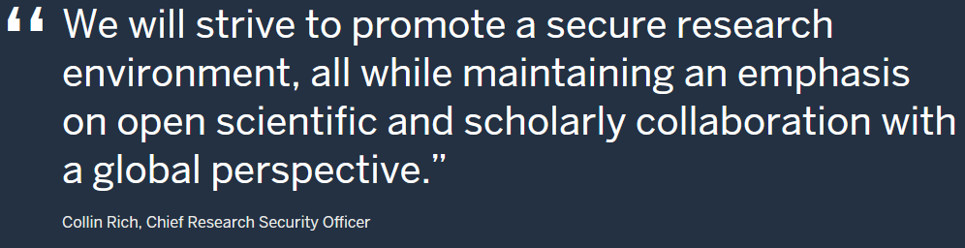
Research Security Office Overview 4
Research Security Program
Visit us at rso.iu.edu to learn more about how we can serve you!

Slide 12
Research Security Program
NSPM-33 Requirements
Research Security Program
Establishment of Research Security Program
Research Security Training
Foreign Travel Security
Cybersecurity
Export Control Training

Slide 13
NSPM-33 Requirement
Establishment of Program
Research Security Program
Section 4(g) of NSPM-33 directs that by January 14, 2022, “heads of funding agencies shall require that research institutions receiving Federal science and engineering support in excess of 50 million dollars per year certify to the funding agency that the institution has established and operates a research security program.

Slide 14
NSPM-33 Requirement
Research Security Training
Research Security Program
Principal Investigators, Co-Principal Investigators, and Key Persons must certify completion of research security training, which includes the following components:
Research Security Threat Awareness
Insider Risk Awareness
Research Security Incident Response
Training is required as part of onboarding of new personnel as well as regular refresher training.

Slide 15
NSPM-33 Requirement
Foreign Travel Security
Research Security Program
Agencies will require research organizations to maintain travel policies for faculty and staff traveling for organization business, teaching, conference attendance, research purposes, or any offers of sponsored travel that would put a person at risk.
Policies should include:
Organizational record of covered international travel by faculty and staff
Advanced disclosure and authorization requirement
Security Briefings
Assistance with electronic device security
Pre-registration requirements

Slide 16
NSPM-33 Requirement
Cybersecurity
Research Security Program
Agencies should require that research organizations satisfy the cybersecurity element of the research security program requirement.
Aside from cybersecurity training, these cybersecurity requirements apply to access control, network security, anti-virus software, incident response, etc. that are outside of the researcher’s control.
Never forget though…
you are the frontline of cybersecurity. Recognize. Rethink. Report.

Slide 17
Federal Sponsor Implementation of NSPM-33
Office for Research Administration
INDIANA UNIVERSITY

Slide 18
NSPM-33 Disclosure Policy

Slide 19
Standardized Requirements and Processes for Disclosure
Disclosure requirements, dictating who is required to disclose and what activities must be disclosed, will be standardized across federal sponsors to the greatest extent practicable.
Disclosure forms and formats will be standardized across research sponsors to the greatest extent practicable.
Recipients of federal funding will be required to update all disclosures before an award of support, at least annually, and more frequently as federal sponsors deem appropriate.

Slide 20
Who is Required to Disclose Information?
All individuals designated in an application as senior/key personnel, except
Program Directors, training faculty, and other individuals involved in the oversight of training grants
Individuals categorized as Other Significant Contributors
All senior/key personnel, excluding consultants, in progress reports when there has been a change in active other support, except
Program Directors, training faculty, and other individuals involved in the oversight of training grants

Slide 21
What Needs to be Disclosed?
Academic, professional, or institutional appointments and positions, whether or not remuneration is received, and, whether full-time, part-time, or voluntary
Postdoctoral scholars, students, or visiting scholars who are supported by an external entity, whether or not they work on federally-funded research projects
Consulting activities related to research
Travel supported/paid by an external entity to perform research activities with an associated time commitment
In-kind contributions

Slide 22

Disclosure Forms
Disclosures should be included in the following three documents:
  Biographical Sketch
    Professional Preparation
    Any and all academic, professional, or institutional appointments and positions (paid or unpaid, full-time, part-time, or voluntary)
  Current & Pending/Other Support
    All projects currently under consideration and all ongoing projects, irrespective of whether support is provided through IU, another organization, or directly to the individual and regardless of whether or not they have monetary value
  Research Performance Progress Report (RPPR)
    Anything new or that has changed since proposal submission, JIT, or previous progress report

Slide 23
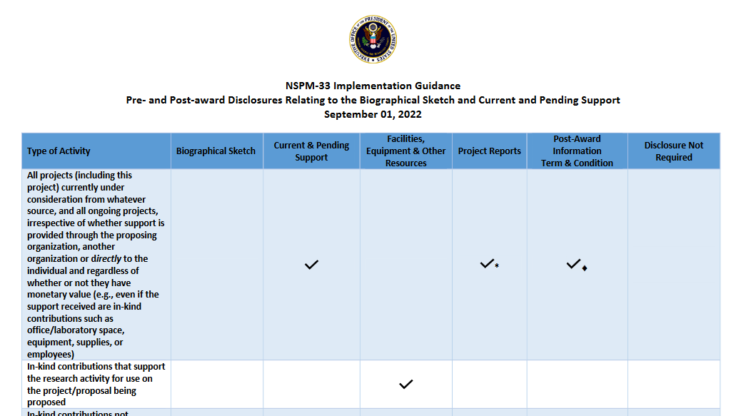
NSPM-33 Implementation Guidance
More information can be found at: https://www.nsf.gov/bfa/dias/policy/nspm_disclosuretable/nspm33_disclosuretable_sept2022.pdf for more informationnformation

Slide 24
NSF Disclosure Requirements

Slide 25
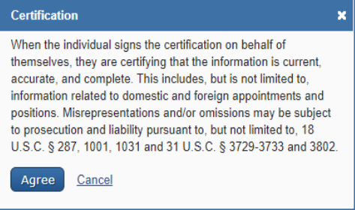
NSF Certifications
Both the Biographical Sketch and the Current and Pending document include a certification.
Senior/Key personnel must certify that the information is accurate, current and complete.
Research.gov and Grants.gov only accept the versions prepared in SciENcv.
Certification is completed upon download of the document.
Refer to the PAPPG, Chapters II.D.2.h(i) and II.D.2.h(ii) and to the biographical sketch and current and pending (other) support pages for policy guidance.

Slide 26
NSF Disclosure Requirements
Proposal Submission: Biographical Sketch, Current and Pending (Other) Support, and Collaborators and Other Affiliations must be submitted.
Pre-Award: Updated Current and Pending (Other) Support will be requested by the NSF Program Officer and must be submitted for senior personnel before an award can be made.
Post-Award: If IU discovers that a disclosure should have been submitted at the time of proposal submission, but was not, we have 30 days to submit a post-award request to NSF. This is completed by a new, separate “Post Award Information” notification which provides more space that the “Other” notification that was being used previously.
Project Reports: PIs and co-PIs must specify whether new, active other support has been received in their annual and final annual project reports. If yes, they must include updated Current and Pending (Other) Support information

Slide 27

NSF PAPPG
Spring 2024 Effective Date (Anticipated)
New definitions for malign foreign talent recruitment programs (MFTRP), countries of concern, and institutions of higher education
Parties to MFTRP from a country of concern are considered ineligible to serve as senior personnel
New certifications regarding MFTRP by the organization and for senior/key persons
If awarded, PIs and co-PIs will be required to certify annually during the life of the award
Foreign gifts and contracts disclosure requirement

Slide 28
NIH Disclosure Requirements

Slide 29
NIH Disclosure Requirements
NIH requires awardees to report foreign activities through documentation of foreign components, other support, and financial conflict of interest. NIH is seeking to identify the following:
  Security and integrity concerns of publicly funded U.S. research
  Potential scientific and budgetary overlap with proposed research
  Investigator and staff over commitment (effort greater than 100%)

Slide 30
What Is a Foreign Component?
A foreign component is defined as “[t]he performance of any significant scientific element or segment of a project outside of the United States, either by the recipient or by a researcher employed by a foreign organization, whether or not grant funds are expended.”
NIH prior approval required whenever scope of work includes a “Foreign Component,” i.e., when a significant part of the project is conducted outside of the United States. This includes:
  Performance of work by a researcher or recipient in a foreign location, whether or not NIH grant funds are expended and/or
  Performance of work by a researcher in a foreign location employed or paid for by a foreign organization, whether or not NIH grant funds are expended.

Slide 31
Examples of Foreign Component Activities
Foreign component activities include:
  the involvement of human subjects or animals at a foreign site,
  extensive foreign travel by recipient project staff for the purpose of data collection, surveying, sampling, and similar activities, or
  any activity of the recipient that may have an impact on U.S. foreign policy through involvement in the affairs or environment of a foreign country.

Slide 32
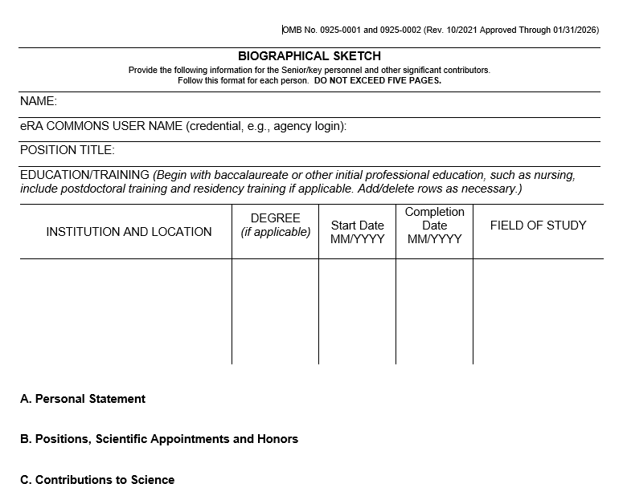
Biographical Sketch
“Positions, Scientific Appointments, and Honors” should include:
    All positions, both domestic and foreign
    All scientific appointments, both domestic and foreign
    All affiliations with foreign entities or governments
    All titled academic, professional, or institutional appointments whether or not renumeration is received

Slide 33
NIH Other Support: What Needs to be Disclosed? to be disclosed?
Positions, Appointments, and Affiliations:
Any and all (visiting and other) academic, professional or institutional appointments held by investigators, including domestic or foreign, paid or unpaid, or full/part-time/voluntary.
Domestic and foreign consulting relationships.
Financial Support:
Sponsored awards held at IU, held at another institution/entity, or held as an individual that support an investigator’s research efforts, including start-up packages from entities other than IU and institutional awards at IU or other institutions that are separately budgeted and accounted.
Non-Financial Resources:
Non-monetary resources that are uniquely available to key personnel such as office or laboratory space, equipment, supplies, employees, scientific materials, and selection to a foreign “talents” or similar-type program.

Slide 34
Supporting Documentation
Supporting Documentation should include:
    Appointment letters or other documents (agreement) related to the terms and conditions of the appointment with foreign entities
    Employment agreements with foreign entities
    Agreements or sponsored funding received as a result of their appointment and/or employment with the foreign entity (received as an individual or through the foreign entities involved)
  Supporting Documentation should not include:
    Agreements or sponsored funding received from foreign entities and accepted via the investigator’s home institution in the US (These must still be listed in Other Support)

Slide 35
NIH Disclosure Requirements Chart
Type of Activity | Report in Biosketch / Application | Report as Foreign Component in Application | Obtain NIH Prior Approval and Report as Foreign Component in RPPR | Report as Other Support (JIT) | Report as Other Support (RPPR) | Report through Institutional COI
All positions and affiliations, including volunteer positions, relevant to the application | X |  |  |  |  | X If salary support
Relevant appointments at foreign institutions – even if labeled as “guest,” “adjunct,” “honorary,” with or without salary support | X |  |  |  |  | X If salary support
The number of person-months devoted to projects, even if there is no salary support or direct personal payments to the scientist |  |  |  | X | X If new
Income, salary, consulting fees, and honoraria in support of an individual's research endeavors |  |  |  | X | X If new | X
Participation in a foreign talent or similar-type programs |  |  |  | X | X If new | X
Ongoing and completed research projects from the past three years that the applicant wishes to highlight | X
All resources and other support, both domestic and foreign, for ongoing research projects, including those conducted at a different institution |  |  |  | X | X If new | X
In-kind contributions from domestic and foreign institutions or governments that support research activities |  |  |  | X | X If new | X
Performance of any significant part of an NIH project outside of the US, whether or not funds are expended |  | X | X If new
Post-doc, student, or visiting scholar supported by a foreign government or another institution |  |  |  | X | X If new
Travel paid by a foreign institution or government over $5,000 per year |  |  |  |  |  | X
Financial interests received from a foreign Institution of higher education or a foreign government |  |  |  |  |  | X

Slide 36
Common Forms

Slide 37
Common Forms for Biographical Sketch and Current and Pending (Other) Support
NSF and NIH have been working closely with other federal sponsors on Common Forms for Biographical Sketch and Current and Pending (Other) Support.
Common Forms have been cleared by the U.S. Office of Science and Technology Policy.
Common Forms implementation expected January 2025.
SciENcv templates will be available May 2025

Slide 38
Persistent Identifier (PID)
Federal sponsors are directed to incorporate PIDs into electronic systems and grant and cooperative agreement application and disclosure processes.
Biographical Sketch Common Form and Current & Pending (Other Support) Common Form include a field for a PID.

Slide 39
Open Research and Contributor ID (ORCID)
ORCID is a unique digital identifier that satisfies PID requirements.
ORCID helps link researchers to their grants, publications, and other research-related work.
NIH requires ORCID identifiers for individuals supported by institutional research training, career development, and other research education awards. NIH recommends ORCID identifiers for all other researchers.
NSF encourages researchers to obtain ORCID identifiers.
Funding and publishing sections in SciENcv will automatically populate using data from ORCID.

Slide 40

ORCID HELP and Resources
ORCID @ IU Indianapolis: https://orcid.iupui.edu/index.html
ORCID @ IU Bloomington: https://guides.libraries.indiana.edu/ORCID-IU

Slide 41
Use of Common Forms
There will be additional changes to NSF formats in FY24 PAPPG but will continue to be as close as possible to the Common Forms
Until the Common Forms are fully adopted by NIH, NIH requires applicants and recipients to use the current NIH Biosketch and Other Support formats for applications, Just-in-Time (JIT) Reports, and Research Performance Progress Reports (RPPRs).

Slide 42
Conflict of Interest and Commitment

Slide 43
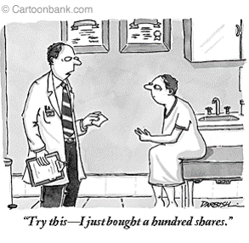
What is a Conflict of Interest?
An interest that has the potential OR the appearance of having the potential to compromise or bias the professional judgment or objectivity of the holder of the interest.
43

Slide 44
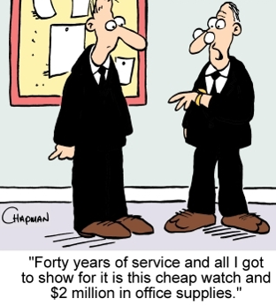
What is a Conflict of Commitment?
Time or effort that an employee devotes to external activities interferes with the employee’s fulfillment of assigned university responsibilities, or an employee makes unauthorized use of university resources in the course of an external activity.

Slide 45
Applicable Authorities
Principles of Ethical Conduct:
  **Section 8 – Refrain from Conflicts of Interest and Commitment
  Conflicts of Interest and Commitment Policy (UA-17)
  Indiana Criminal Code
    IC 35-44.1-1-4 – Conflicts of Interest for Public Servants
    IC 35-44.1-1-3 – Ghost Employment
  Many others!

Slide 46
Employee Responsibilities
Disclose to the unit head any current or potential conflict of interest or commitment as soon as it is known through the COI-C Disclosure portal at one.iu.edu
Devote university work activities to official university functions
Use university resources only in the interest of the university
Consult with supervisor or associated unit head if there is any question about an external activity before engaging in it.

Slide 47
Office of Research Compliance

Slide 48
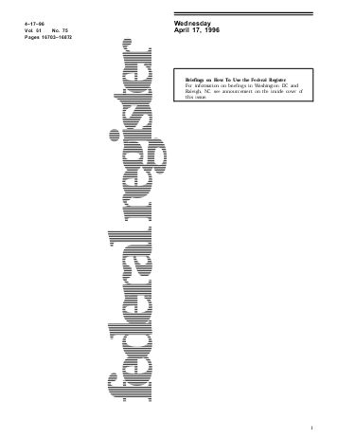
Federal Regulations and IU Policy on Research COI
Regulations on “Objectivity in Research”
“[n]ot designed to prevent or hinder relationships among government, academia, and industry. Rather, the revisions are aimed at facilitating such relationships by increasing transparency and accountability so that the resulting research is considered objective and in the interest of the public.”

Slide 49
Research Conflict of Interest
Disclosure of outside financial interests to the university on our internal IU COI form
Evaluation of the interests to determine if it could directly and significantly impact the design, conduct, or reporting of research
Steps are taken to “manage” any potential overlap
  Disclosure in publications
  Disclosure to participating human subjects
  Potentially restricting the role of conflicted investigators in specific projects

Slide 50
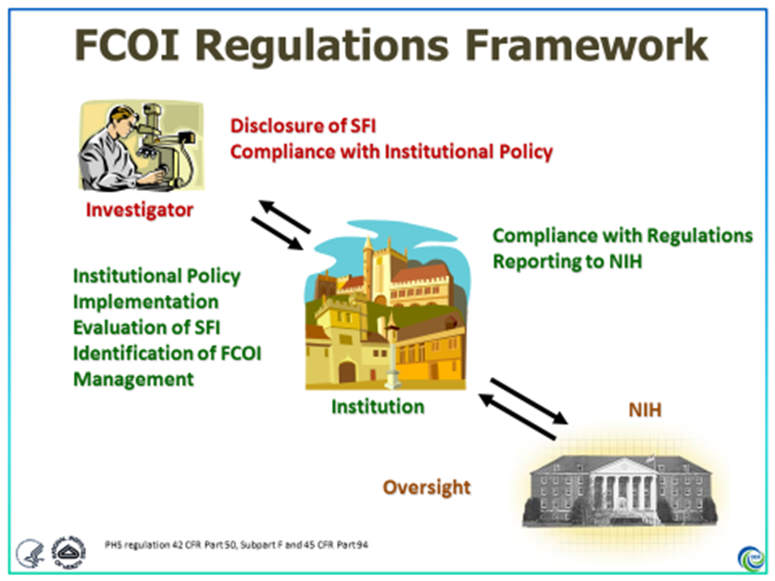
FCOI Regulations Framework

Slide 51

Export Controls
“Export controls” restrict certain listed items and technologies when the US possesses a competitive advantage or national security interest in restricting distribution of that item or technology.

Slide 52
Export Control Training
Most IU research results are “fundamental research.” However, this status is lost when the sponsor must pre-approve the publication of results or when certain foreign nationals are restricted from participating in the research. Additionally, researchers may be using export-controlled items even on fundamental research projects.
Training is provided to those working on restricted research, i.e., research that is not “fundamental research.” This accompanies a technology control plan to ensure security of export-controlled technology.
Typically, combination of in person and online (CITI training) as we set up technology control plans.

Slide 53
IU Federal Relations

Slide 54
Federal Update
The Deterrent Act
Proposals/Amendments of Concern
NDAA

Slide 55
Conclusion

Slide 56
Resources
Resource | Find it here…
National Science Foundation (NSF) Training Modules | https://rso.iu.edu/education-outreach/nsf.html
Reporting a research security concern or question | Email: rsohelp@iu.edu
NSPM-33 Implementation Guidance | https://www.whitehouse.gov/wp-content/uploads/2022/01/010422-NSPM-33-Implementation-Guidance.pdf
Latest research agency updates related to NSPM-33 | https://www.cogr.edu/sites/default/files/Quick%20Reference%20Table%20to%20Current%20and%20Upcoming%20Federal%20Agency%20Requirements%20COGR%20Update%20Nov%202023.pdf

Slide 57
Contact Information
Department | Email
Research Security Office | rsohelp@iu.edu
Office for Research Administration | iuprop@iu.edu
Office for Research Compliance | researchcompliance@iu.edu
Federal Relations | dwasitis@iu.edu

